Slide 1


REPORT
GROUP 4
SOCIAL MEDIA
PRESENTED BY DIGITAL MARKTING TEAM YAT 456

Slide 2
Table of Content
01
ABOUT ALEXLAND
08
WEBSITE
02
BUSINESS MODEL CANVAS
09
SOCIAL MEDIA
03
SWOT ANALYSIS
10
CONTENT CALENDAR
04
COMPETITORS ANALYSIS
11
CONTENT INSIGHTS
05
TARGET AUDIENCES
12
ADS STRATEGY
06
BUYER’S PERSONA
13
RECOMMENDATIONS
07
OBJECTIVES
14
THANK YOU

Slide 3
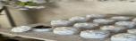

About
Alex Land
Alex Land is a handcrafted brand of concrete decor, combining artistry with strategic marketing to expand reach, boost engagement, and drive sustainable growth.

Slide 4










Business
Model Canvas
Customer Relationship
Customer Segments
Value Propositions
Key Activities
Key Partners
Women (18-35) interested in modern home decor.
DIY enthusiasts looking for raw materials & molds.
Event planners
Interior designers & home stylists.
Fast customer support via WhatsApp and social media
Discounts and offers
Custom design
Unique & modern handcrafted concrete decor.
Eco-friendly & recyclable materials.
High-quality, affordable, & handmade products.
Customization options for personalized designs.
Artistic designs that suit various interior styles.
Design & produce handcrafted
Market & sell via Instagram, TikTok, Facebook & website.
Enhance brand identity
engaging content (photos, videos, reels).
Manage orders, packaging & delivery.
courses
Suppliers of raw materials (cement, colors, molds, additives)
Shipping and logistics companies
Exhibitions & art markets participatio
Key Resources
Selling ready-made products through the online store
Custom design orders
Supplying products to home decor retailers
Offering workshops
Channel
Social media platforms (Instagram, Facebook, TikTok)
our store
Cost Structure
Revenue Stream
Online sales of ready-made products.
Custom design orders.
Exhibitions & art markets participation.
Supplying home decor retailers.
Workshops for concrete decor crafting.
Costs of raw materials and production
store rent and serves (electricity )
Shipping and delivery costs

Slide 5


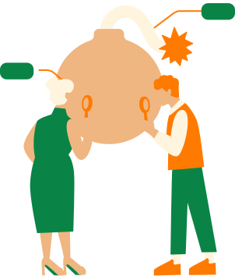
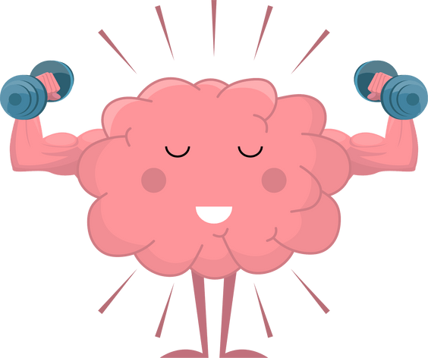

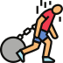

SWOT ANALYSIS
Strenths
threats
Competition
Changing Tastes
losing followers interest due to gab time between product batches
Product Quality
Variety
customization
accessibility
industrial courses
Weaknesses
Opportunities
Brand Awareness
unupdated social media platforms
Not focusing enough on the industry courses they provide
gap time between product batches, which leaves followers waiting for new products
Market Expansion
Digital Marketing
Special Occasions
growing community of people interested in their courses

Slide 6
SWOT ANALYSIS
Strengths
Product Quality:
Alex Land consistently delivers high-quality concrete decorative pieces, demonstrating durability and aesthetic appeal. This builds customer trust and encourages repeat purchases.
They emphasize the precise formulation and craftsmanship involved in each piece, highlighting the value proposition beyond mass-produced alternatives.
Variety:
Alex Land offers a diverse range of concrete decorative pieces, catering to various styles and preferences. This allows them to attract a wider customer base.
customization :
Alex Land provides customization options, allowing customers to personalize their concrete decorative pieces. This adds a unique selling point and enhances customer satisfaction. Customization may include personalized engravings, specific color requests, or tailored sizes, creating a bespoke experience.
accessibility :
Alex Land offers multiple channels for customers to purchase their products, including in-store visits and nationwide shipping. The store visits will also help the customer see the product in real life and the variety of products, which will make them buy more products.
industrial courses :
Alex Land offers comprehensive industrial courses on concrete decorative piece creation, covering everything from formulation to shaping.These courses provide valuable knowledge and skills, attracting individuals interested in learning the craft.

Slide 7

SWOT ANALYSIS
Weaknesses
Brand Awareness:
Alex Land's brand awareness is limited, hindering its ability to reach a wider audience and compete effectively.
un-updated social media platforms:
Alex Land's social media platforms are not consistently updated, resulting in low engagement and missed opportunities to connect with potential customers.
Not focusing enough on the industry courses they provide :
While the courses are a strong asset, Alex Land is not focusing on them enough, they are not advertising them as much as they should.
Gap Time Between Product Batches:
The significant gap time between product batches leads to customer frustration and potential loss of interest.
Followers waiting for new products may seek alternatives if the wait is too long, impacting sales and brand loyalty.

Slide 8
SWOT ANALYSIS
Opportunities
Market Expansion :
Alex Land can expand its market reach by targeting new customer segments and geographical areas.
Digital Marketing :
Investing in digital marketing strategies, such as social media advertising can increase brand visibility and drive online sales.
Special Occasions :
Offering gift sets and personalized items for special occasions can also enhance customer engagement.
growing community of people interested in their courses :
Alex land has a great opportunity to grow this community by providing the courses they provide, and also creating a community on their social media platforms.

Slide 9
SWOT ANALYSIS
Threats
Production Time Delays:
Handmade products take longer to create, affecting marketing timelines.
Solution: Plan campaigns around available stock, use pre-orders, and showcase production progress to engage customers.losing followers' interest due to gap time between product batches
Low conversion rates:
Customers hesitate due to pricing or trust issues.
Solution: Highlight uniqueness, showcase customer reviews, offer flexible payment options, and optimize the website for better user experience.

Slide 10
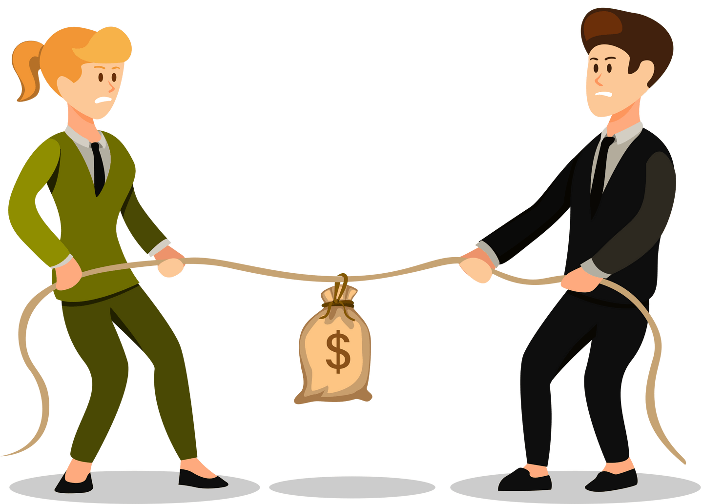
competitors

Slide 11
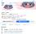
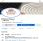
Our Competitor
COMPETITORS DOKAN AL FN
COMPETITORS MOLD ZONE
Number of Followers: 30k
Number of Followers: 5.3k
Borcelle Fashion has currently become a market leader in vintage fashion collections. They offer clothing lines for both men and women. They design classic clothing that is suitable for many market segments.
Rimberio Fashion is well known for its modern clothing designs and styles. With their affordable prices, Rimberio Fashion has successfully become popular among fashionistas.

Slide 12
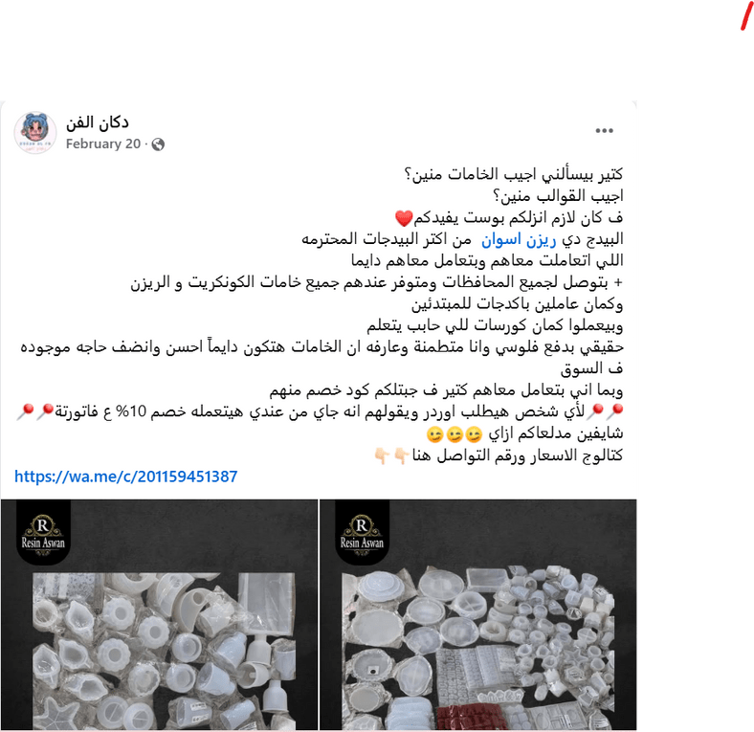
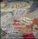
Competitor
Dokan Al Fn
Industry: Handmade art and crafts.
Location: Egypt.
Products: Artistic handmade pieces, concrete decorations, scented candles.
Engagement: 2.3K likes, 30K followers.
Shipping: Available across Egypt.
Notes: Focuses on customized art pieces, filming every piece making process
Strengths
Weaknesses
High Frequency posting
Making process videos
engaging fun content
they offer final pieces only
no mass production
low quality photography due to high frequency posting

Slide 13
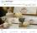
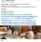
Competitor
mold zone
Industry: Handmade home decor.
Products: Modern decorative pieces, including unique vases
Engagement: 5.2K likes, 5.3K followers.
Shipping: Not explicitly mentioned.
Comparison & Key Insights:
Target Audience:
Dokan Al Fn appeals to art lovers and those seeking custom-designed pieces.
Mold Zone focuses on home decor enthusiasts who prefer elegant and contemporary designs.
Social Engagement:
Dokan Al Fn has a larger follower base, suggesting strong audience interest.
Mold Zone has a moderate following but might target a niche market.
Strengths
Weaknesses
High end positioning
focus on decoration concept
engaging fun content
they offer final pieces only
no customization

Slide 14

Target Audience

Slide 15
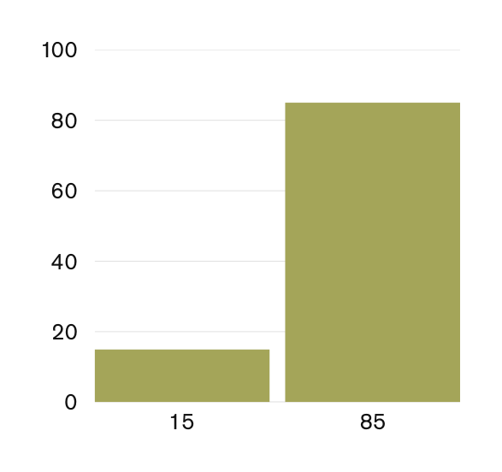
Target Audience
GENDER
AGE
18 to 25 years old
25 to 35 years old
35-45 years old
55%
30%
15%
LOCATION
Alexandria (current )
80%
cairo
20%

Slide 16
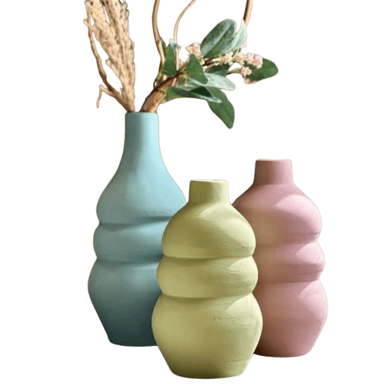
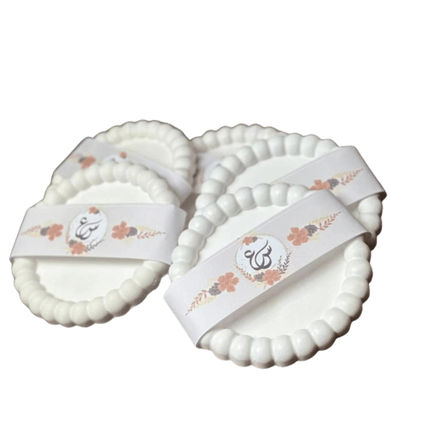
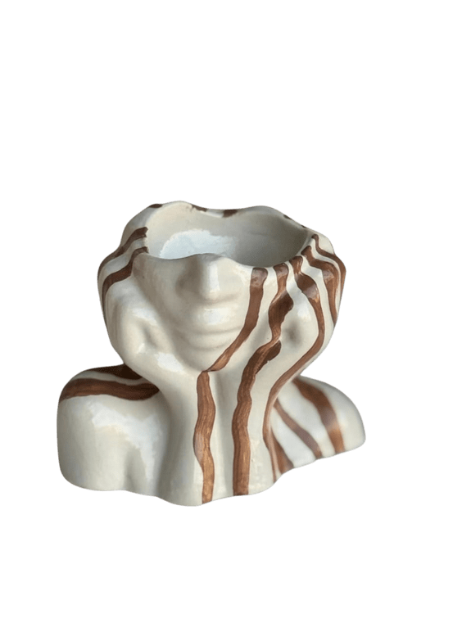
Target Audience
1. Home Decor Items Made of Concrete
Target Audience:
• Women aged 25 to 45,• Attracted to unique, artsy, or out-of-the-box home items.
• Newlyweds or couples furnishing their homes..
Interests:
• Interior design pages on Instagram and Pinterest.
• Shopping at handmade fairs or online stores.
2. Baby Shower, Engagement, and Wedding Giveaways
Target Audience:
• New moms or pregnant women are preparing for a baby shower.
• Brides and grooms planning their engagement or wedding ceremonies..
Interests:
• Facebook groups for baby shower and wedding preparations.
3. Concrete Art Courses and concrete without finish
Target Audience:
• Young women aged 18 to 35 with a passion for DIY and handmade crafts.
• People interested in starting a small business or working from home.
• Art and craft enthusiasts.
Interests:
• Online courses
• Handmade product groups on Facebook.
• Small business ideas and creative side hustles.

Slide 17



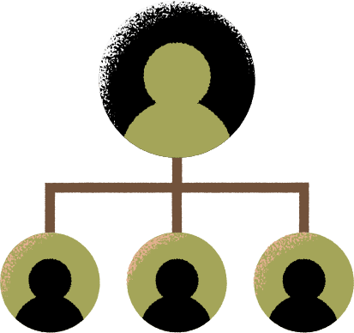


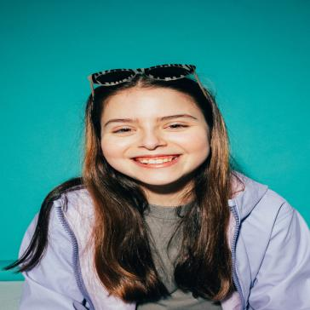
BUYER PERSONA
SALMA
NADA
NADEEN
HEAD OF SOCIAL MEDIA
CONTENT CREATOR

Slide 18


GOALS
- To launch her own small business selling home decor items made from unfinished concrete.
NADA
PERSONALITY
STUDENT
- Balancing her studies with her new business venture.
- Limited experience in running a business, requiring her to learn as she goes.
AGE
20
GENDER
FEMALE
LOCATION
ALEX

Slide 19
GOALS
* Goals: Find unique and thoughtful gifts for her baby's first celebration, save time and effort, create a memorable experience for her guests
NADEEN
PERSONALITY
STUDENT
* Pain Points: Feeling stressed about planning the baby shower, difficulty finding unique and practical gifts, worried about exceeding her budget
AGE
28
GENDER
FEMALE
LOCATION
ALEX

Slide 20

GOALS
Find unique and memorable wedding favors for her guests.
Complete wedding preparations efficiently and on time.
Impress her guests with thoughtful gifts.
PERSONALITY
SALMA
Limited time due to demanding wedding planning tasks.
Overwhelmed by the vast number of wedding favor options.
Struggling to find favors that reflect her personal style and the wedding theme.
Needs a reliable and convenient way to purchase favors.
STUDENT
AGE
29
GENDER
FEMALE
LOCATION
SMOHA

Slide 21

OBJECTIVES

Slide 22
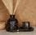
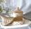
OBJECTIVES
1-Increase sales by 15% within the next six months.
Objectives:
1. Launch targeted paid marketing campaigns.
2. Enhance the online shopping experience
3. Offer promotions and discounts to boost purchase rates.
4.Analyze sales and customer data to identify growth opportunities.
3-Increase social media engagement rate by 30% within six months.
Objectives:
Post interactive content pieces per week (polls, questions, contests, behind-the-scenes videos).
Organize a monthly contest to encourage users to engage (e.g., share product photos or suggest new designs).
Reduce response time to comments and messages to under 3 hours to enhance customer interaction.
Host two live sessions per month to answer audience questions and showcase new products.
Encourage User-Generated Content (UGC) by offering discounts or gifts for the best customer posts.
2-Increase brand awareness by 20% within six months.
Objectives:
Launch and optimize social media campaigns to reach potential customers.
Collaborate with influencers in the home decor and handmade products niche.
Run targeted Facebook and Instagram ads with a reach of at least 10,000 impressions.
Increase engagement rate by 30% through interactive content (polls, quizzes, and user-generated posts).
Generate at least 1,000 new followers across all social media platforms.
4- Increase traffic to social media account followers 30%
Objectives:
Increase traffic to social media account (facebook - tiktok - Instagram )

Slide 23
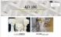
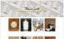
Website
INFOGRAPHICPLAN
WEBSITE HOME PAGE
WEBSITE PRODUCT GALLERY
Handcrafted concrete decor made with care and creativity. Explore our products & read simple guides about working with concrete.
Discover our unique collection of handmade concrete pieces — from elegant vases to custom event favors.
Each item is crafted with care, using high-quality, eco-friendly materials.

Slide 24







Social Media
INFOGRAPHICPLAN
FACEBOOK
566 Follower 488 like
INSTGRAM
35 users
TIKTOK
44 follower
GOOGLE SITE
1 wisits
TELGRAM
10 users

Slide 25

content calendar

Slide 26



(01)
4 posts / Weak
2 stories/ day
January 2025
SUNDAY | MONDAY | TUESDAY | WEDNESDAY | THURSDAY | FRIDAY | SATURDAY
 |  |  | 01 CREATIVE DESIGN /NEW YEAR SEASON/ HIGHLIGHTING PRODUCT | 02 TRENDING MUSIC REAL | 03 | 04 New Year offer/ promotional Carousel
 |  |  | 01 CREATIVE DESIGN /NEW YEAR SEASON/ HIGHLIGHTING PRODUCT | 02 TRENDING MUSIC REAL | 03 | 04 New Year offer/ promotional Carousel
05 | 06 Trending music real Highlight new products | 07 | 08 TUTORIAL VIDIO | 09 | 10 BEHIND-THE-SCENES | 11 UGC Post
05 | 06 Trending music real Highlight new products | 07 | 08 TUTORIAL VIDIO | 09 | 10 BEHIND-THE-SCENES | 11 UGC Post
12 | 13 Creative Image Design | 14 Comedy video voice over | 15 | 16 Worksop of Alexland post | 17 | 18 HOMEDECOR IDEAS VIDEO
12 | 13 Creative Image Design | 14 Comedy video voice over | 15 | 16 Worksop of Alexland post | 17 | 18 HOMEDECOR IDEAS VIDEO
19 عروض نص السنة CAROUSEL | 20 | 21 Trending music Real | 22 | 23 Tutorial Content | 24 | 25 PROMOTIONAL & SEASONAL CONTENT
19 عروض نص السنة CAROUSEL | 20 | 21 Trending music Real | 22 | 23 Tutorial Content | 24 | 25 PROMOTIONAL & SEASONAL CONTENT
26 | 27 TRENDING MUSIC REAL | 28 | 29 Testimonial Post | 30 | 31 Carousel For new products promotion | Behind the sence pouring and coloring process
26 | 27 TRENDING MUSIC REAL | 28 | 29 Testimonial Post | 30 | 31 Carousel For new products promotion | Behind the sence pouring and coloring process

Slide 27
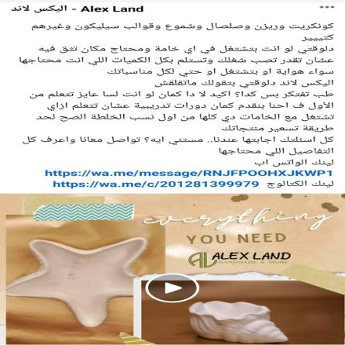
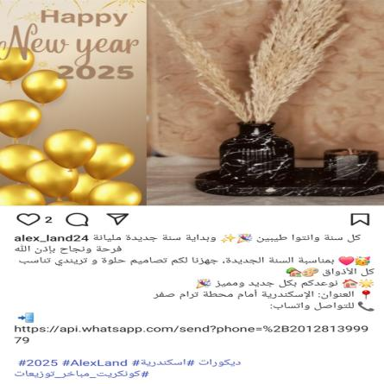
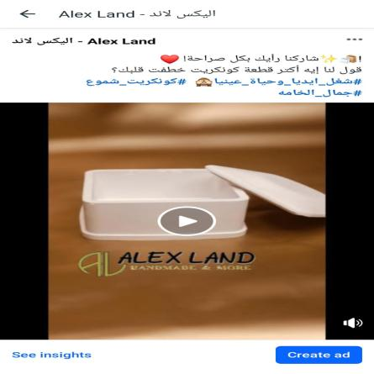
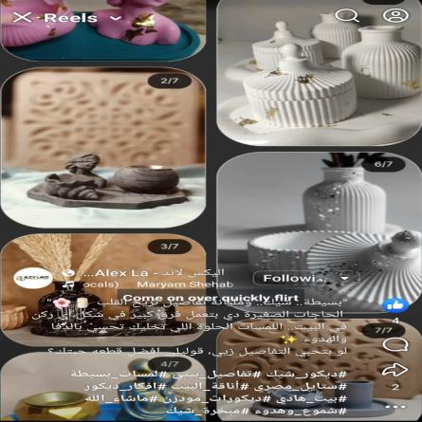
January Content Examples:

Slide 28

(02)
Februry 2025
4 posts/week
2 Stories/ day
SUNDAY | MONDAY | TUESDAY | WEDNESDAY | THURSDAY | FRIDAY | SATURDAY
 |  |  |  |  |  | 01 SPECIAL OCCASIONS products توزيعات السبوع وكتب الكتاب
 |  |  |  |  |  | 01 SPECIAL OCCASIONS products توزيعات السبوع وكتب الكتاب
02 | 03 REEL: MAKING RAW PIECES READY FOR WORKSHOPS OR PAINTING | 04 | 05 Behind-the-Scenes Reel: Creating Romantic-Inspired Concrete Art | 06 | 07 Story Series: “Which gift would you choose?” Poll | 08 Trending music reel
02 | 03 REEL: MAKING RAW PIECES READY FOR WORKSHOPS OR PAINTING | 04 | 05 Behind-the-Scenes Reel: Creating Romantic-Inspired Concrete Art | 06 | 07 Story Series: “Which gift would you choose?” Poll | 08 Trending music reel
09 Offer on Unfinished Pieces for crafters (Buy 2, Get 1) | 10 | 11 Valentine’s Gift Ideas featuring romantic pieces Carousel | 12 | 13 TRENDING MUSIC REEL |  | 15 Reel: Crafting elegant, oriental-inspired pieces for Ramadan
09 Offer on Unfinished Pieces for crafters (Buy 2, Get 1) | 10 | 11 Valentine’s Gift Ideas featuring romantic pieces Carousel | 12 | 13 TRENDING MUSIC REEL |  | 15 Reel: Crafting elegant, oriental-inspired pieces for Ramadan
16 | 17 Carousel Post: Design ideas for Ramadan table or corner styling | 18 Story: Countdown sticker + question box “What are you looking for this Ramadan?” | 19 | 20 Announcing Late Feb Workshop – themed around gifting or | 21 | 22 Ramadan Trending sound reel
16 | 17 Carousel Post: Design ideas for Ramadan table or corner styling | 18 Story: Countdown sticker + question box “What are you looking for this Ramadan?” | 19 | 20 Announcing Late Feb Workshop – themed around gifting or | 21 | 22 Ramadan Trending sound reel
23 Carousel Post: Design ideas for Ramadan table or corner styling | 24 | 25 UGC post customer feedback | 26 | 27 TRENDING SOUND REEL | 28 Tutorial & decor tips video
23 Carousel Post: Design ideas for Ramadan table or corner styling | 24 | 25 UGC post customer feedback | 26 | 27 TRENDING SOUND REEL | 28 Tutorial & decor tips video

Slide 29
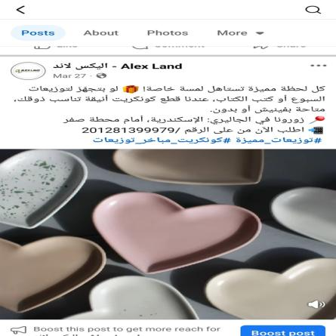
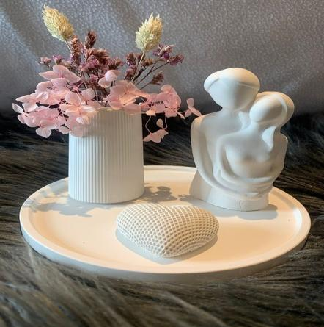
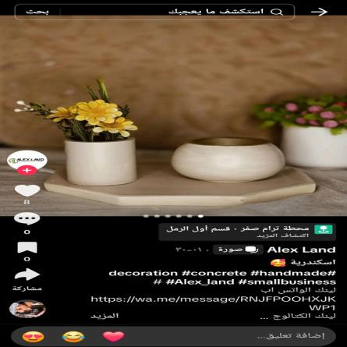
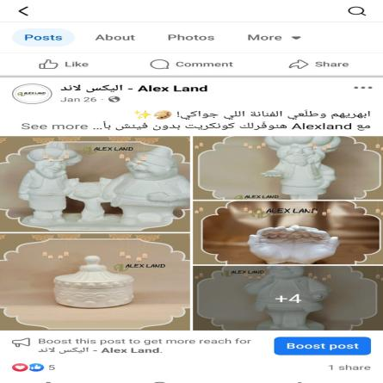
February Posts Examples:

Slide 30
(3)
Mars 2025
4 posts/ week
2Stories/day
SUNDAY | MONDAY | TUESDAY | WEDNESDAY | THURSDAY | FRIDAY | SATURDAY
 |  |  |  |  |  | 01 Reel: Crafting Ramadan Decor • Styling Tips + UGC
 |  |  |  |  |  | 01 Reel: Crafting Ramadan Decor • Styling Tips + UGC
02 | 03 Testimonial Post | 04 | 05 Gift Idea Posts • Reel: Gift Packaging | 06 | 07 Workshop Announcement + Recap creative Design visual | 08 Tutorial Gift Idea Posts • Reel: Gift Packaging
02 | 03 Testimonial Post | 04 | 05 Gift Idea Posts • Reel: Gift Packaging | 06 | 07 Workshop Announcement + Recap creative Design visual | 08 Tutorial Gift Idea Posts • Reel: Gift Packaging
09 Baby Shower Giveaways product &UGC | 10 | 11 Ramadan Vibes Reel hilight products | 12 | 13 Story Poll + Last-Minute Reminder | 14 Testimonial & Custemer feedback | 15
09 Baby Shower Giveaways product &UGC | 10 | 11 Ramadan Vibes Reel hilight products | 12 | 13 Story Poll + Last-Minute Reminder | 14 Testimonial & Custemer feedback | 15
16 | 17 Mother’s Day Gift Idea Posts | 18 | 19 Mother day music reel | 20 | 21 CAROUSEL HILIGHTING UNFINISHED PIECES | 22
16 | 17 Mother’s Day Gift Idea Posts | 18 | 19 Mother day music reel | 20 | 21 CAROUSEL HILIGHTING UNFINISHED PIECES | 22
24 TUTORIAL POST pouring and coloring | 25 | 26 Engagement/Katb El Ketab & boby shower Giveaways pormotion | 27 | 28 | 29 | 30 Eid Elfiter vibes trending music reel
24 TUTORIAL POST pouring and coloring | 25 | 26 Engagement/Katb El Ketab & boby shower Giveaways pormotion | 27 | 28 | 29 | 30 Eid Elfiter vibes trending music reel

Slide 31
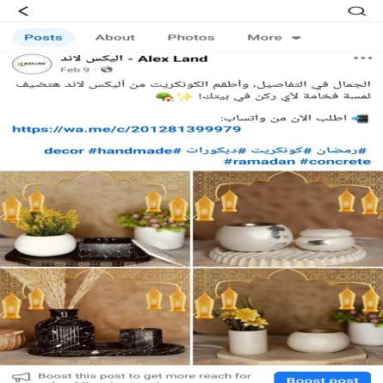
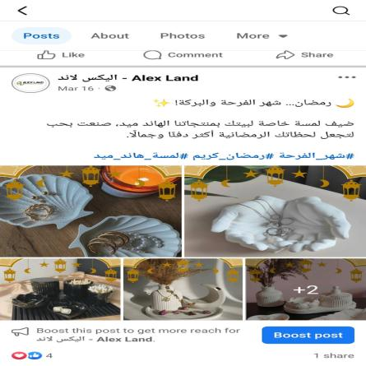
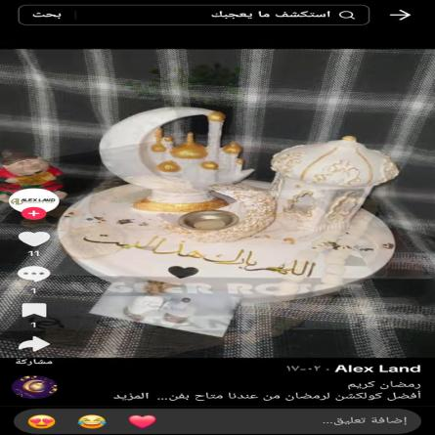
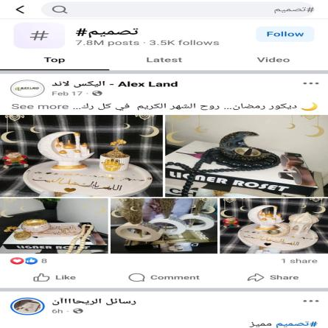
Mars Posts Examples:

Slide 32
(04)
4 posts /week
2 stories /day
April 2025
SUNDAY | MONDAY | TUESDAY | WEDNESDAY | THURSDAY | FRIDAY | SATURDAY
31 | 01 TRENDING MUSIC REEL | 02 | 03 Educational & Tutorial post Increase engagement | 04 | 05 CAROUSEL WITH TRENDING MUSIC Increase virality | 06
31 | 01 TRENDING MUSIC REEL | 02 | 03 Educational & Tutorial post Increase engagement | 04 | 05 CAROUSEL WITH TRENDING MUSIC Increase virality | 06
07 Promotional & Seasonal content Inspire creativity, and CTA enrollment in handmade courses. - Carousel | 08 | 09 UGC music reel | 10 | 11 SEASONAL &PROMOTIONAL -SHOWCASE SHAM EL NSSIM NEW DESIGNS . AWARNESS& ENGAGEMENT | 12 | 13 trending comedy voice over reel
07 Promotional & Seasonal content Inspire creativity, and CTA enrollment in handmade courses. - Carousel | 08 | 09 UGC music reel | 10 | 11 SEASONAL &PROMOTIONAL -SHOWCASE SHAM EL NSSIM NEW DESIGNS . AWARNESS& ENGAGEMENT | 12 | 13 trending comedy voice over reel
14 Tutorial post | 15 SEASONAL PROMOTION | 13 | 14 Creative Design | 15 | 16 Trending music reel | 17
14 Tutorial post | 15 SEASONAL PROMOTION | 13 | 14 Creative Design | 15 | 16 Trending music reel | 17
18 SEASONAL POSTS | 19 | 20 BEHIND THE SENCE | 21 | 22 UGC POST | 23 | 24 CAROUSEL HIGHLIGHTS NEW PRODUCTS
18 SEASONAL POSTS | 19 | 20 BEHIND THE SENCE | 21 | 22 UGC POST | 23 | 24 CAROUSEL HIGHLIGHTS NEW PRODUCTS
25 | 26 | 27 | 28 | 29 | 01 | 02
25 | 26 | 27 | 28 | 29 | 01 | 02

Slide 33
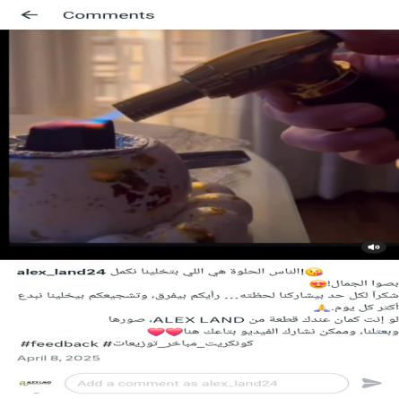
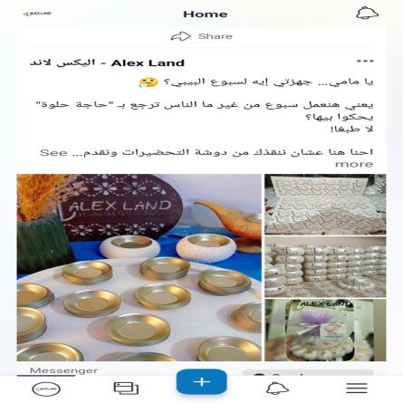
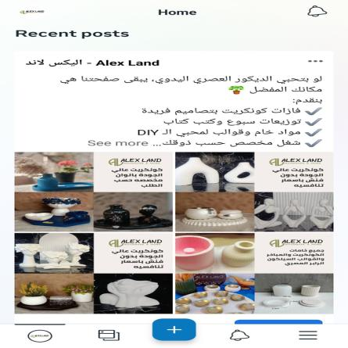
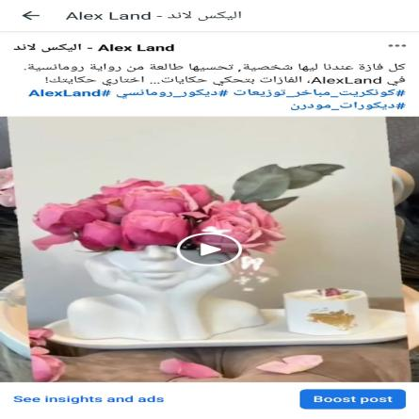
April Posts Examples:

Slide 34

Content insights

Slide 35
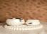
key milestones
01
EXPAND BRAND AWARENESS TO WIDER AUDIENCE
20% WITHIN SIX MONTHS.
02
INCREASE THE NUMBER OF FOLLOWERS AND ENGAGEMENT
30% WITHIN SIX MONTHS.
03
INCREASE TRAFFIC TO SOCIAL MEDIA ACCOUNT
INCREASE TRAFFIC BY 35%

Slide 36
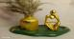

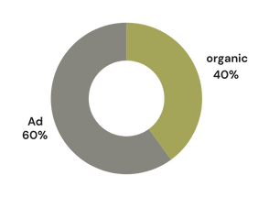
Social Media Performance
FACEBOOK FOLLOWERS | TOTAL REACH | TOTAL VIEWS
566 FOLLOW 488 LIKE | 8.5K Reach | 26.7k View
TOTAL INTERACTIONS | WATCH TIME | ENAGAGEMENT RATE
509 | 16 H 6 M | 10%

Slide 37
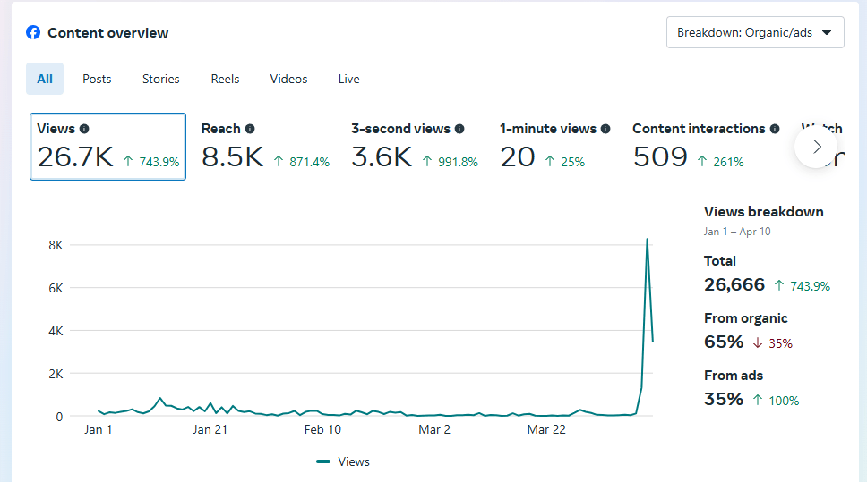
Content overview Facebook
"By the end of the project period, we successfully achieved an acceptable reach and noticeable engagement, reflecting improved content performance and organic growth."
Content overview
6

Slide 38
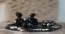

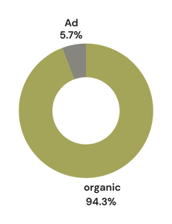
Social Media Performance
INSTGRAM FOLLOWERS | TOTAL REACH | TOTAL VIEWS
36 FOLLOW | 366 Reach | 726 View

Slide 39
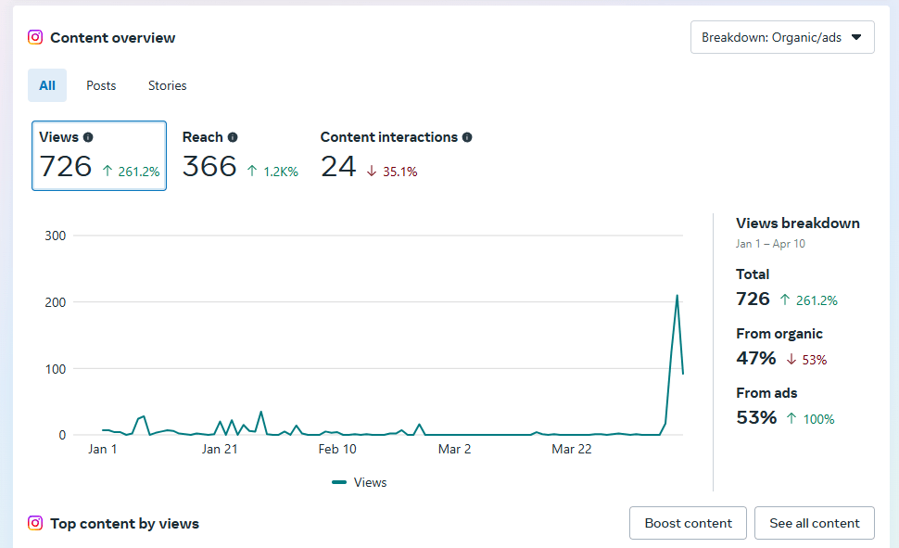
Total fb performance
"Although Instagram performance hasn't reached its full potential yet, there is steady and promising progress, and with continued optimization, better results are expected soon."
Content overview
6

Slide 40
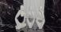

Social Media Performance
TIKTOK FOLLOWERS | PROFILE VIEW | TOTAL VIEWS
44 FOLLOW | 175 Reach | 16k View
LIKES | SHARE | COMMENTS
302 | 15 | 7

Slide 41
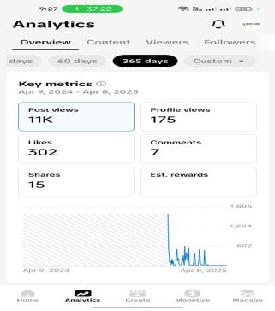
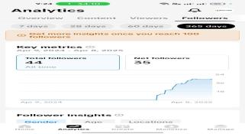
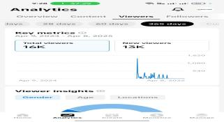
Impact on Business
TikTok is showing relatively good engagement compared to other platforms, offering great potential to reach new audiences — especially within our target age group. With consistent short-form, engaging content, stronger performance is expected soon.
A cost-effective way
Direct engage to customers
Access to a large and diverse audience.
6

Slide 42

Ads Strategy

Slide 43
Social Media Campaign
CAMPAIGN
TOTAL BUDGET 400
DATE UPLOADED
REACHED AUDIENCE
Brand Awareness facebook page likes | 8 April 2024 | 4,765 Reach
Content: carousle with our services Target Audience: Women aged 18–35, living in Alexandria Platform: Facebook Page Likes Campaign Objective: Increase the number of real, interested followers | 1 day | 200 egp
Engagement Messages | 7 April 2024 | 2,443 Reach
Post Facebook reel Audience: women 18 - 45 Platform: Facebook massages Objective: Boost reactions, comments, and shares | 2 day | 200 egp

Slide 44
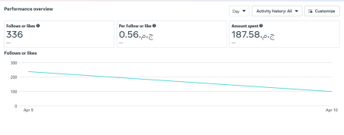
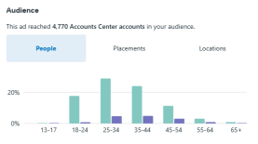

1- Brand Awareness facebook page likes
CAMPAIGN
BUDGET 200
Brand Awareness facebook page likes
Content: carousle with our services Target Audience: Women aged 18–35, living in Alexandria Platform: Facebook Page Likes Campaign Objective: Increase the number of real, interested followers

Slide 45



2- Engagement Messages
CAMPAIGN
BUDGET 200
Engagement Messages
Post Facebook reel Audience: women 18 - 45 Page Like Objective: Boost reactions, comments, and shares

Slide 46

Recommendations

Slide 47

Recommendations
1. INFLUENCER COLLABORATION
Partner with local artisans and lifestyle influencers to showcase the uniqueness of Alexland’s handmade products.
Encourage influencer-led product demonstrations and reviews to build trust and engagement.
2. WEBSITE ENHANCEment
Improve the website’s navigation and checkout process for a seamless shopping experience.
Add a section highlighting the craftsmanship behind each product to enhance storytelling.
4. IMPLEMENTATION TIMELINE
Month 1: Launch an influencer marketing campaign and optimize product descriptions.
Month 2: Enhance website UX/UI and introduce a loyalty program for repeat customers.
Month 3: Launch a local campaign in key markets and prepare for a major seasonal promotion.
3. QUARTERLY PLANNING & MONTHLY REVIEW AND STRATEGY ADJUSTMENT
Conduct monthly performance reviews based on key KPIs such as engagement, conversion rates, and customer retention.
Adjust social media content, product listings, and advertising strategies based on insights from these reviews.

Slide 48




Our Team
Aya khamis
HuDa Hassan
Rasha Abdel monsef
Nahla Mansy

Slide 49


Slide 50


THANK YOU
@alex_land24
https://sites.google.com/alexland

